Slide 1
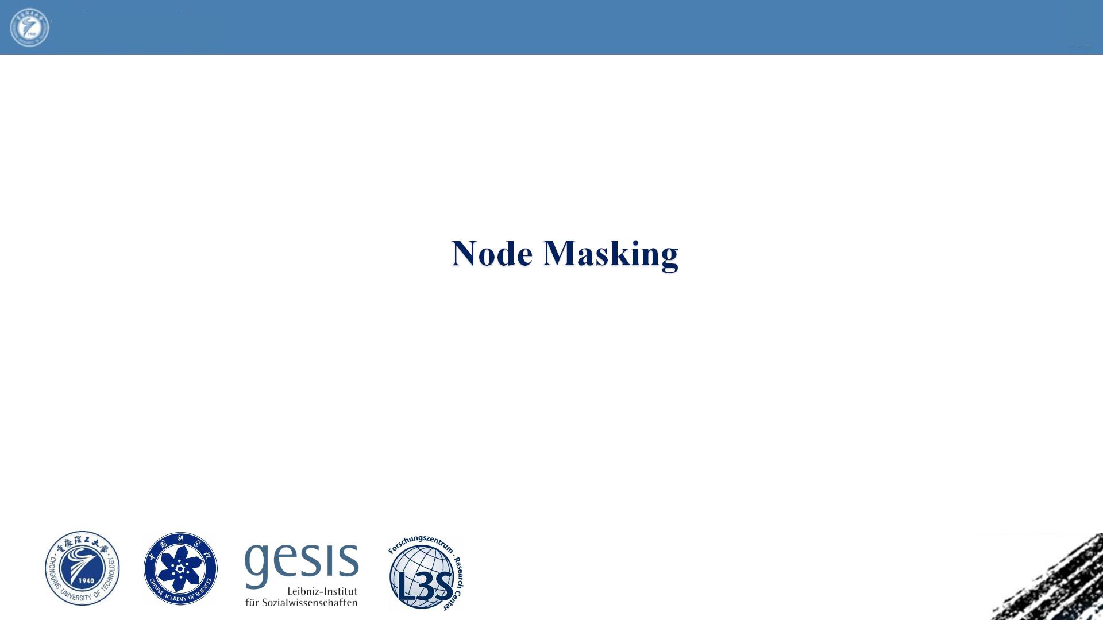
Chongqing University
of Technology
ATA I
Advanced Technique of
Artificial Intelligence
Reported by Chenghong Li

Slide 2
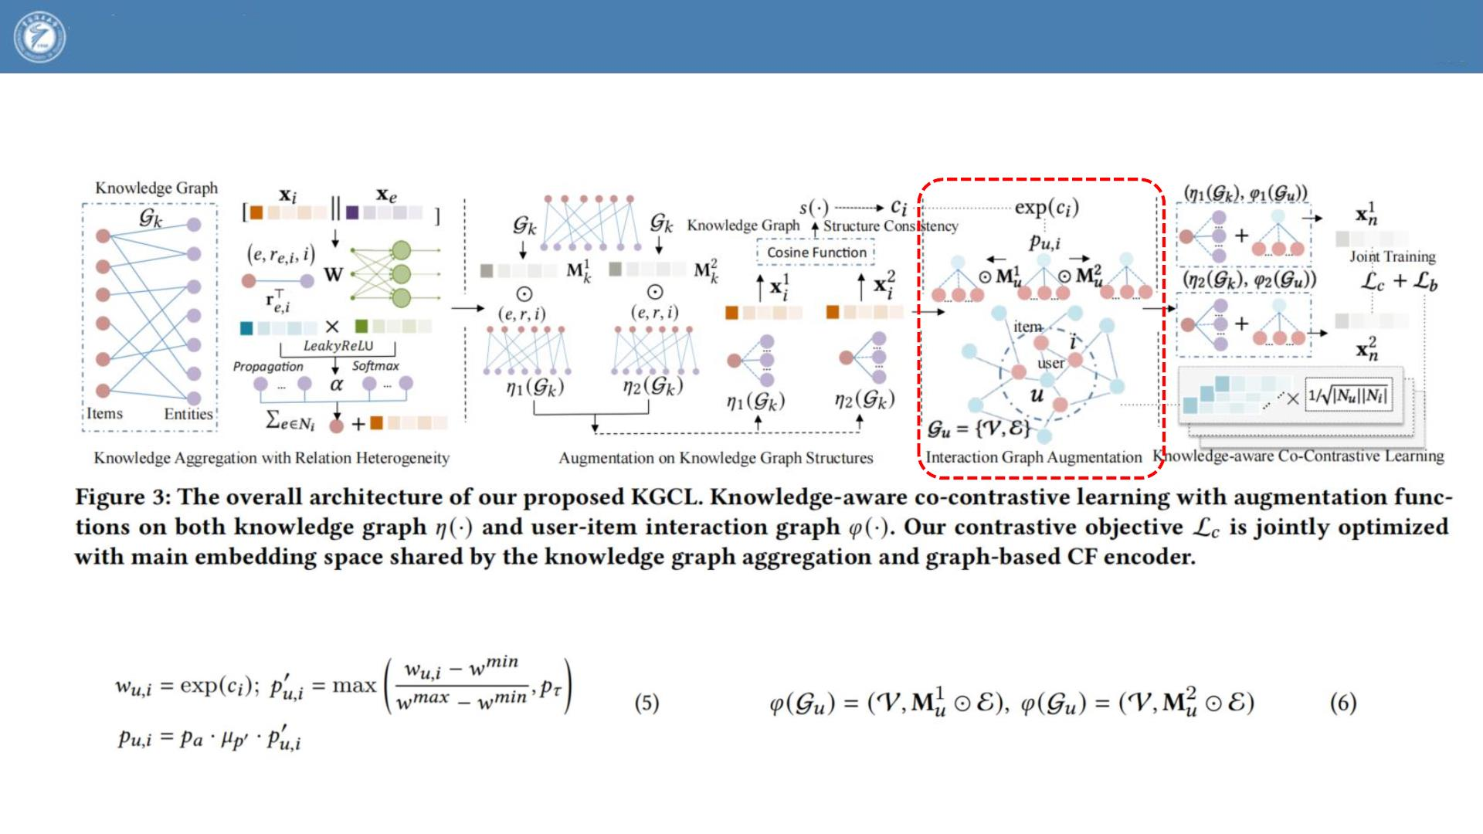
Chongqing University
of Technology
ATA I
Advanced Technique of
Artificial Intelligence
2022_WWW_GRAND+_Scalable Graph Random Neural Networks

Slide 3
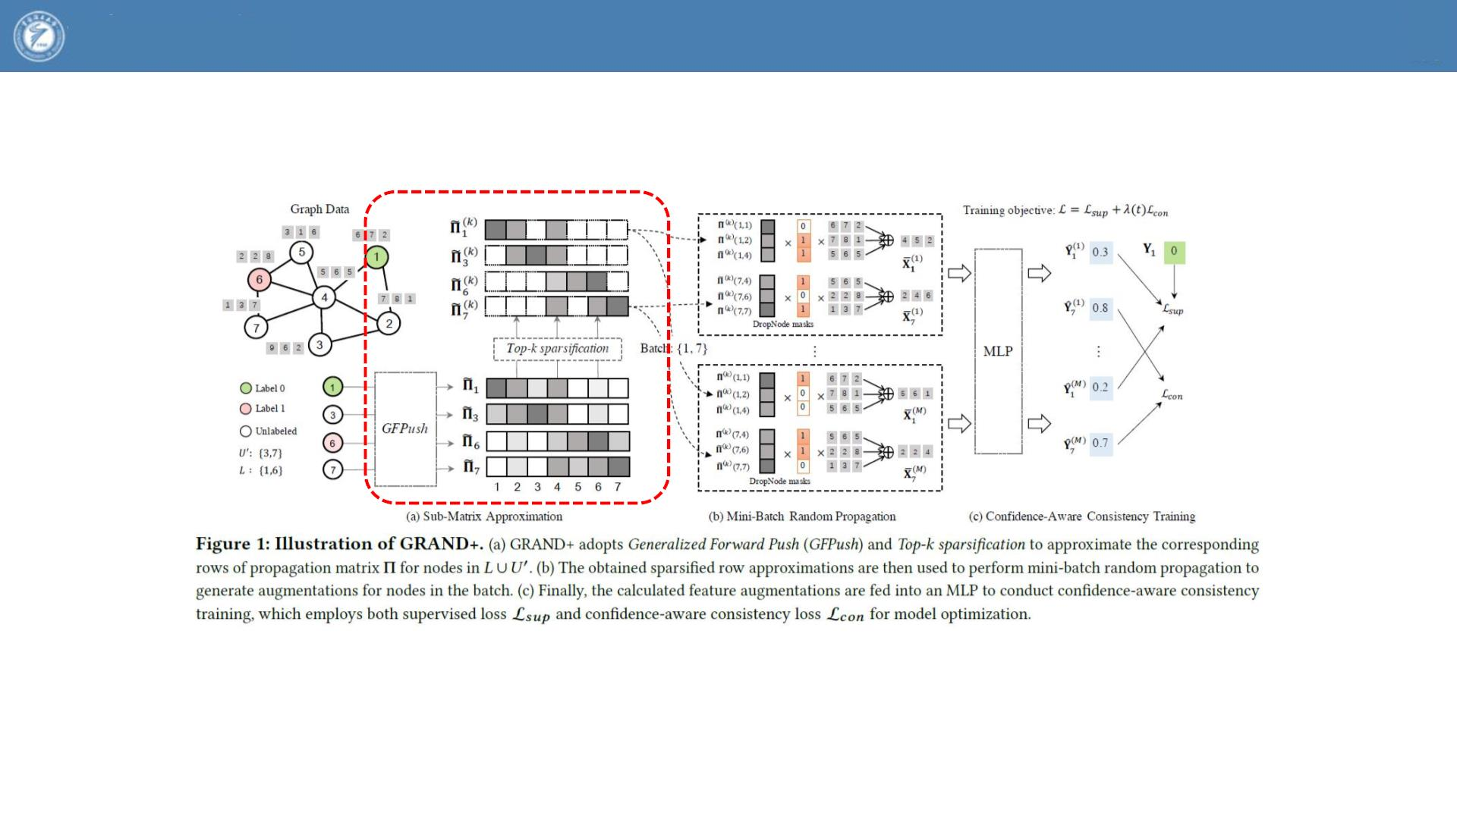
Chongqing University
of Technology
ATA I
Advanced Technique of
Artificial Intelligence
2022_WWW_GRAND+_Scalable Graph Random Neural Networks

Slide 4
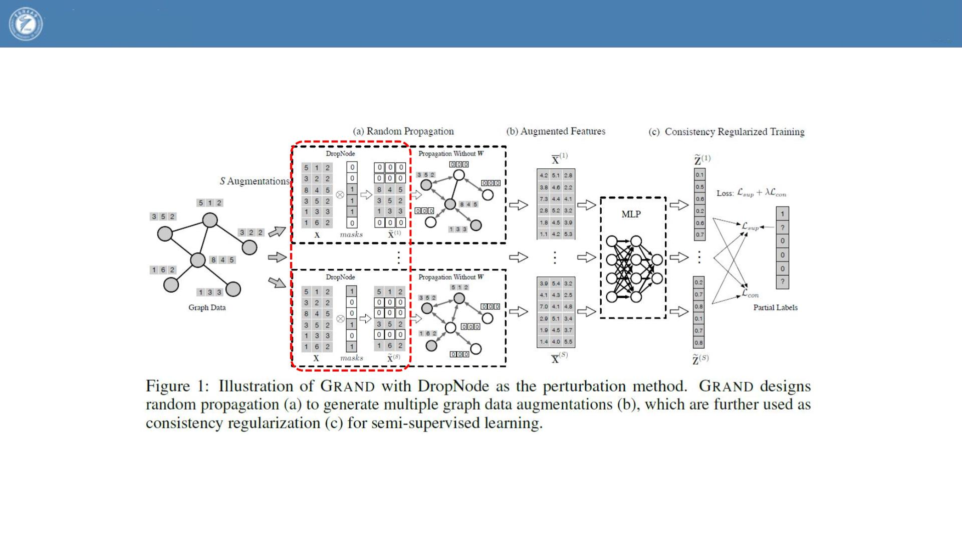
Chongqing University
of Technology
ATA I
Advanced Technique of
Artificial Intelligence
2020_NeurIPS_Graph Random Neural Networks for Semi-Supervised Learning on Graphs

